Slide 1
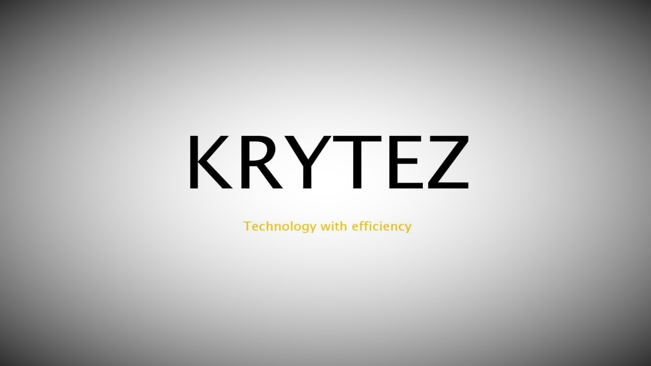

Slide 2
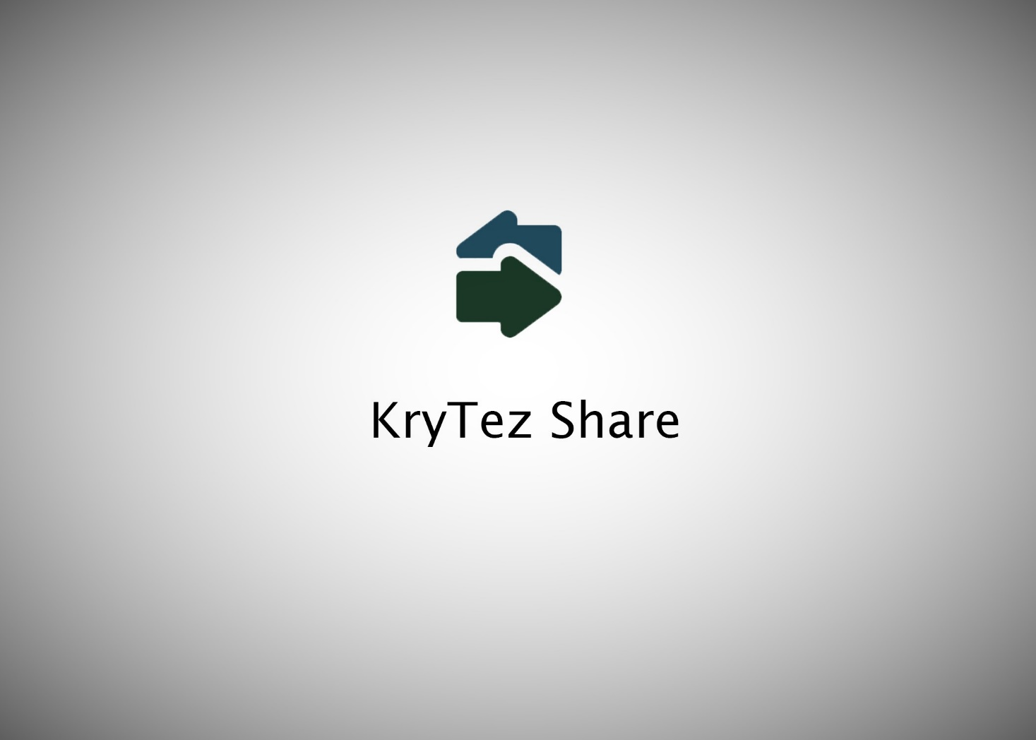
-BY
SUMANTH

Slide 3

KryTez Share Features
Easy to use
Simple user interface
ZERO connection problems
Extremely low app size (5MB)
High transfer speed ranging from 6-9MBps on an average

Slide 4
KryTez Share Features
Available for windows and android
Cross-platform sharing
(Windows-Android & Android-Windows)
Ethernet PC to PC transfer
Efficiency is the main goal

